Slide 1
Goal tracker
Aaron Kirby
Krishna Teja Ayinala
Sindhura Bonthu
Sathvika Komalla

Slide 2
Overview
Goal Tracker is a stand-alone application designed for use by a single user.
It will organize a user’s task list in order to meet a goal.
It will help user by prioritizing entered tasks.
Useful for individuals with no goals, or those poor at prioritizing their time or energy.

Slide 3
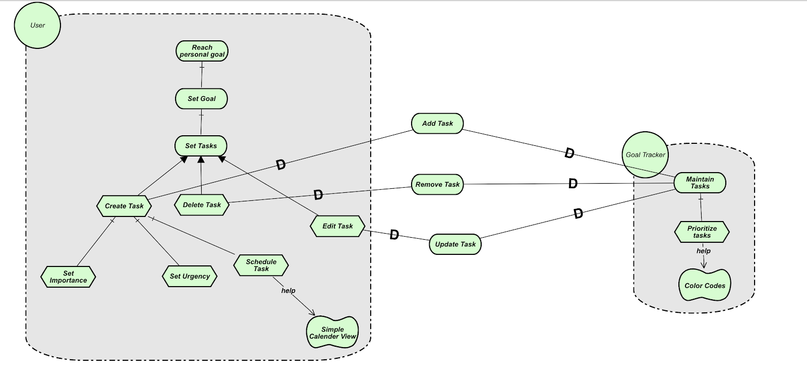
Goals

Slide 4
Functional Requirements
A user can
create goal.
create tasks associated with a goal.
view tasks in month-view.
sort and prioritize tasks.

Slide 5
dEMO
Adding and viewing tasks
The tasks are prioritized by color
Red = urgent & important
Orange = urgent, but not important
Green = not urgent, but important
Black = not urgent or important

Slide 6
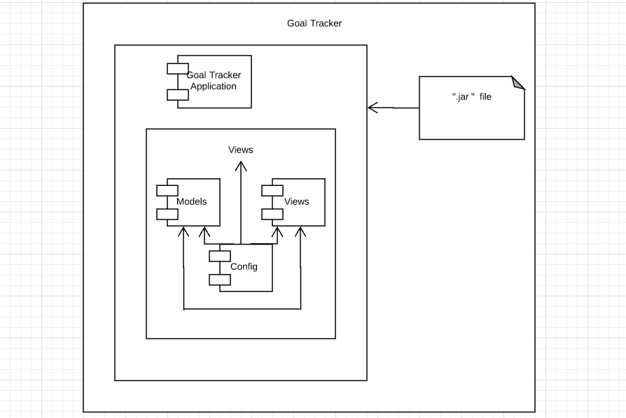
Development view

Slide 7
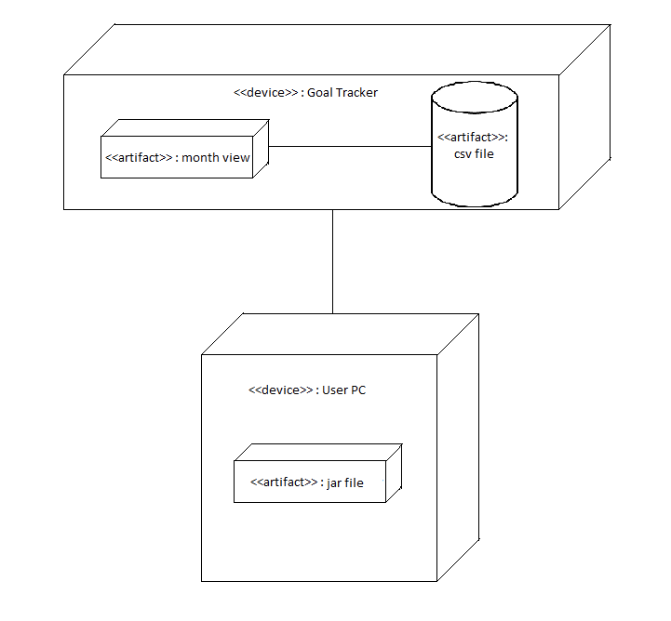
Deployment view

Slide 8
Quality Requirements
Usability: concerned with specifying the user interface and end-end user interactions with the system.
Usability Factors:
Ease of learning: Is the Goal Tracker application easy to learn for various users?
Task Efficiency: Does frequent users perform their tasks efficiently?

Slide 9
Quality requirements(cont..)
Usability metrics:
Measure: Number of mouse clicks required by user for creating tasks
Measuring Usability:
Task 1 : Creating a goal by the user
Task 2 : Creating a task by the user
Requirements:
Max 3 mouse clicks for user to create and save a goal
Max 2 mouse clicks for user to create and save task

Slide 10
Formalization
Every task must be associated with a goal. In order to do that, a goal has to be declared before defining its related tasks
We use CafeObj formal specification language to formalize the above requirement.

Slide 11
Formalization(contd..)
mod MyGoals*{
protecting(STRING) – predefined type: String
eq goalid(create) = empty-list .
eq goalid(task(create,S)) = S .
eq checkGoalID(create, goalID) = false
eq chackGoalID (task(T,goalid), goalID) = true .
eq taskID(create) = empty-list
eq taskID(task(create,S)) = S .
eq taskID (cons(T,S)) = taskid (S) . }

Slide 12


